Slide 1
SCS3212 Machine Learning Algorithms & Programming
Part 1. Introduction
Peter Waiganjo Wagacha
2026

Slide 2
Learning & Adaptation
”Modification of a behavioral tendency by expertise.” (Webster, 1984)
”A learning machine, broadly defined is any device whose actions are influenced by past experiences.” (Nilsson, 1965)
“Learning is any process by which a system improves performance from experience.” - Herbert Simon
”Any change in a system that allows it to perform better the second time on repetition of the same task or on another task drawn from the same population.” (Simon, 1983)
”An improvement in information processing ability that results from information processing activity.” (Tanimoto, 1990)

Slide 3
Why Learn?
Machine learning is programming computers to optimize a performance criterion using example data or past experience.
There is no need to “learn” to calculate the payroll
Learning is used when:
Humans are unable to explain their expertise (e.g. speech recognition)
Solution changes in time (e.g. routing on a computer or road network)
Human expertise does not exist or we don’t know “how to” (e.g. navigating on Mars)
Solution needs to be adapted to particular cases (e.g. user biometrics)

Slide 4
Learning involves
Learning general models from data
Data is cheap and abundant. Knowledge is expensive and scarce
Build a model that is a good and useful approximation to the data
Examples:
From customer transactions to computer behaviour
From social media posts to opinions
From mobile loan data to automated loan appraisals and funds disbursement
Classification of texts based on content
From student tests performance records to identifying knowledge gaps
..

Slide 5
Why is Machine Learning Possible?
Mass Storage
More data available
Higher Performance of Computer
Larger memory in handling the data
Greater computational power, GPU,
Distribution/Clusters
…And of course the Algorithms/improvements

Slide 6
Disciplines relevant to ML
Artificial intelligence
Bayesian methods
Statistics
Information theory
Computational complexity theory
Philosophy
Psychology and neurobiology
Control theory
Game Theory
Notes:
Grp2 23rdFeb

Slide 7
Learning
Machine Learning (Mitchell 1997)
Learn from past experiences
Improve the performances of intelligent programs
Definition:
A computer program is said to learn from experience E with respect to some class of tasks T and performance measure P, if its performance at tasks in T, as measured by P, improves with experience.

Slide 8
Learning Problem
Learning: improving with experience at some task
:>Improve over task T
:>With respect to performance measure P
:>Based on experience E
Example: Learn to play draughts:
T: play draughts
P: percentage of games won in a tournament
E: opportunity to play against itself

Slide 9
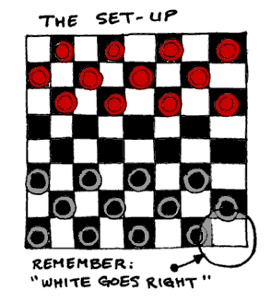

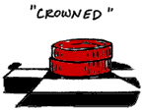
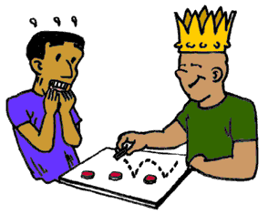
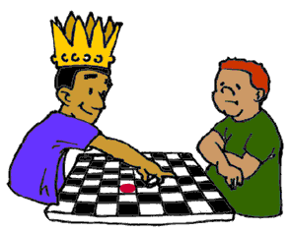
Learning to play draught board game

Slide 10
Learning to play Draughts
T: play draughts
P: percentage of games won
E: What experience?
In designing the learning system we need to choose:
What exactly should be learned?
How shall it be represented?
What specific algorithm to learn it?

Slide 11
Type of Training Experience
Direct or indirect?
Direct: board state -> correct move
Indirect: outcome of a complete game
Credit assignment problem
Teacher or no Teacher?
Teacher selects board states
Learner can select board states
that are confusing and is assisted by the teacher
learner has complete control of the board states and training -no teacher
Is training experience representative of performance goal?
Training playing against itself
Performance evaluated playing against world champion

Slide 12
Possible Definition of Target Function
If b is a final board state that is won then
V(b) = 100
If b is a final board state that is lost then
V(b) = -100
If b is a final board state that is drawn then V(b)=0
If b is not a final board state, then V(b)=V(b’), where b’ is the best final board state that can be achieved starting from b and playing optimally until the end of the game.
Gives correct values that are possible within realistic time bounds

Slide 13
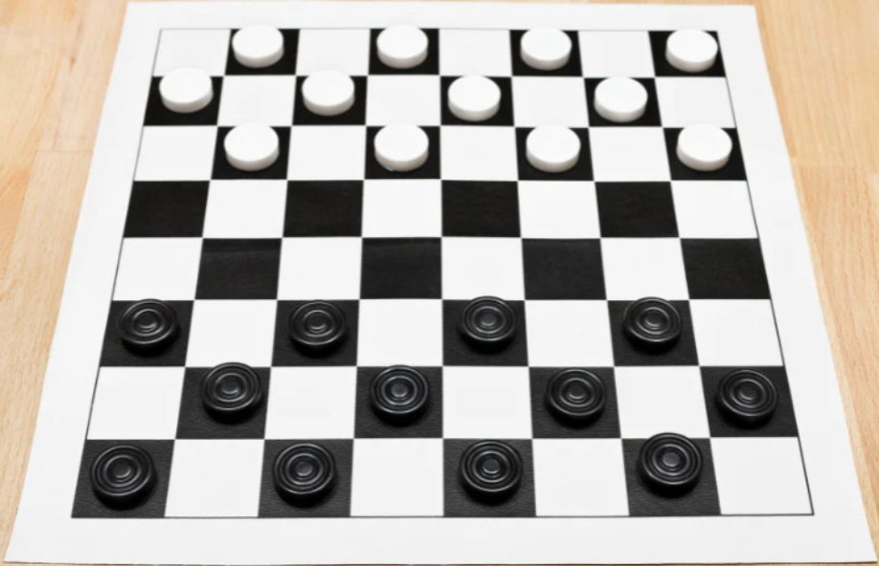
Draughts board

Slide 14
State Space Search
V(b)= ?
V(b)= max_{i} V(b_{i})
m₂ : b→b₂
m₃ : b→b₃
m₁ : b→b₁

Slide 15
State Space Search
V(b₁)= ?
V(b₁)= min_{i} V(b_{i})
m₅ : b→b₅
m₆ : b→b₆
m₄ : b→b₄

Slide 16
Final Board States
Black wins: V(b)=-100
Red wins: V(b)=100
draw: V(b)=0

Slide 17
Learning Problems Examples
Text Classification
Task T - Assigning texts to a set of predefined categories
Performance measure P - Precision and recall of each category
Training experiences E - A database of texts with their corresponding categories
Hand written words
Task T - Recognizing hand-written words
Performance measure P - Percentage of words correctly classified
Training experiences E - Database of human-labeled images of handwritten words

Slide 18
Learning Problem Example – Mobile-phone based Lending Requests appraisal
Mobile lending applications
Task T:
Distinguish ”good” requests (applicants) from ”risky” applicants who are mobile phone users.
Performance measure P :
?
Experience E :
? (direct/indirect)
Target function :
?
Notes:
E.G. Tala,

Slide 19
Learning Problem Example – email spam detection
Email spam detection
Task T:
?
Performance measure P :
?
Experience E :
? (direct/indirect)
Target function :
?
Notes:
T: Categorize email messages as spam or legitimate. P: Percentage of email messages correctly classified. E: Database of emails, some with human-given labels

Slide 20
Types of Learning (learning paradigms)
Supervised (inductive) learning
Provided: training data + desired outputs (labels)
Unsupervised learning
Provided: training data (without desired outputs)
Reinforcement learning
Rewards (or penalties) from sequence of actions

Slide 21
Code
Paradigm shift
Data
Answers
Rules
Data
Rules
Answers
Data
Rules
C
L
A
S
S
I
C
M
L

Slide 22
Model
Paradigm shift
Data
Answers
Rules
Data
Predictions
Labels
= targets
Data
Predictions
C
L
A
S
S
I
C
M
L

Slide 23
Model
Paradigm shift
Data
Answers
Rules
Data
Predictions
Labels
= targets
Data
Predictions
C
L
A
S
S
I
C
Rule-based
Data-driven
M
L
Goal is to predict

Slide 24
Issues in Machine Learning
What algorithms can approximate functions well and when?
How does the number of training examples influence accuracy?
How does the complexity of hypothesis representation impact it?
How does noisy data influence accuracy?
What are the theoretical limits of learnability?

Slide 25
Finally,..
We need to think about:
What will be learned?
How it will be learned?
How will we evaluate performance?
What is the source of the data that is required?
What learning methods will we use?

Slide 26
Resources
A Friendly Introduction to Machine Learning (Coursera) https://youtu.be/IpGxLWOIZy4
Introduction to Machine Learning (MIT Open Courseware) https://youtu.be/h0e2HAPTGF4

